Slide 1

Progress Seminar on Portfolio Website
Presented By
Ruchika
Parshionikar
Guided By
Mrs. Roshni
Talmale
Department of Computer Science & Engineering
S. B. JAIN INSTITUTE OF TECHNOLOGY MANAGEMENT AND RESEARCH,NAGPUR
An Autonomous Institute, Affiliated to RTMNU, Nagpur

Slide 2
Contents
Problem Statement & Objectives
Introduction
Literature Survey
Use case Diagram
Technology to be Used
Screenshots
Works
Advantages
Conclusion
References
2
S. B. Jain Institute of Technology Management and Research

Slide 3
Problem Statement & Objectives
Problem Statement
A resume only provides bullet points. In this era of real world, everyone wants evidence but resume is all about mentioning our work and skills. Many of online portfolios contains only the name of your work. It would be better if we start to show our work as well through our personal portfolio. It allows us to show and not just tell.
Objectives
To give a prospective client, a sense of who you are, what you can do and whether you are a person they should hire.
To show your work to employers.
It presents evidence of your relevant skills and abilities.
3
S. B. Jain Institute of Technology Management and Research

Slide 4
Introduction
Include resume, qualifications and skills, projects, audio, video, etc.
An online portfolio is a website you create to show off your skills, experience, projects, and even your personality to potential clients /employees.
Engineers, Computer Scientists, photographers , designers and other creative people to have a way to showcase and promote their work.
S. B. Jain Institute of Technology Management and Research
4

Slide 5
Literature Survey
Websites / Paper / Article | Reviews / Findings
https://kinsta.com/blog/portfolio-website/ | This website provides an overview of perfect portfolio. It includes what is portfolio, why you need it and essential elements of portfolio.
https://www.freshbooks.com/blog/how-to-create-online-portfolios-that-win-clients | This website provides an overview of essential elements of portfolio such as Home Page, Project Page, About page, Contact page, etc.
S. B. Jain Institute of Technology Management and research
5

Slide 6
Use case Diagram
Create portfolio
View Portfolio
Edit portfolio
Contact
Portfolio Creator
Portfolio Viewer
Retrieve
Information
S. B. Jain Institute of Technology Management and research
6

Slide 7
Technology to be Use
Front End:
Javascript, CSS, HTML
IDE: VScode
Hardware used: Laptop (8GB RAM)
S. B. Jain Institute of Technology Management and research
7

Slide 8
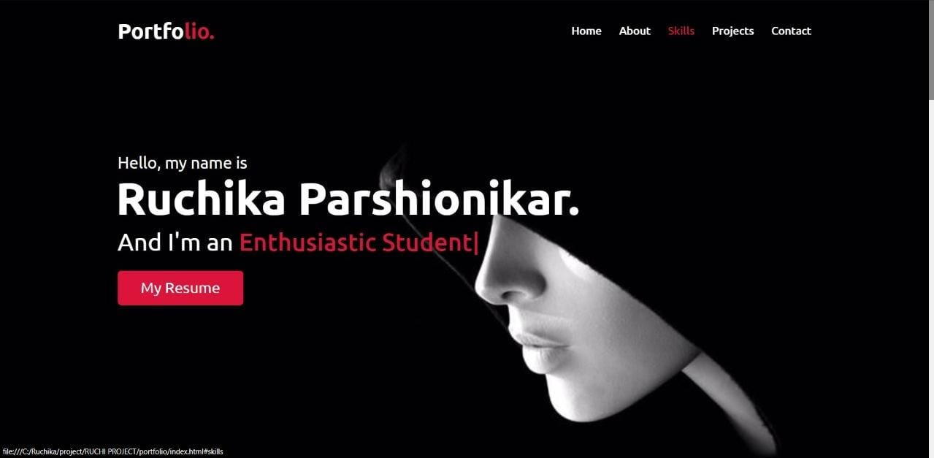
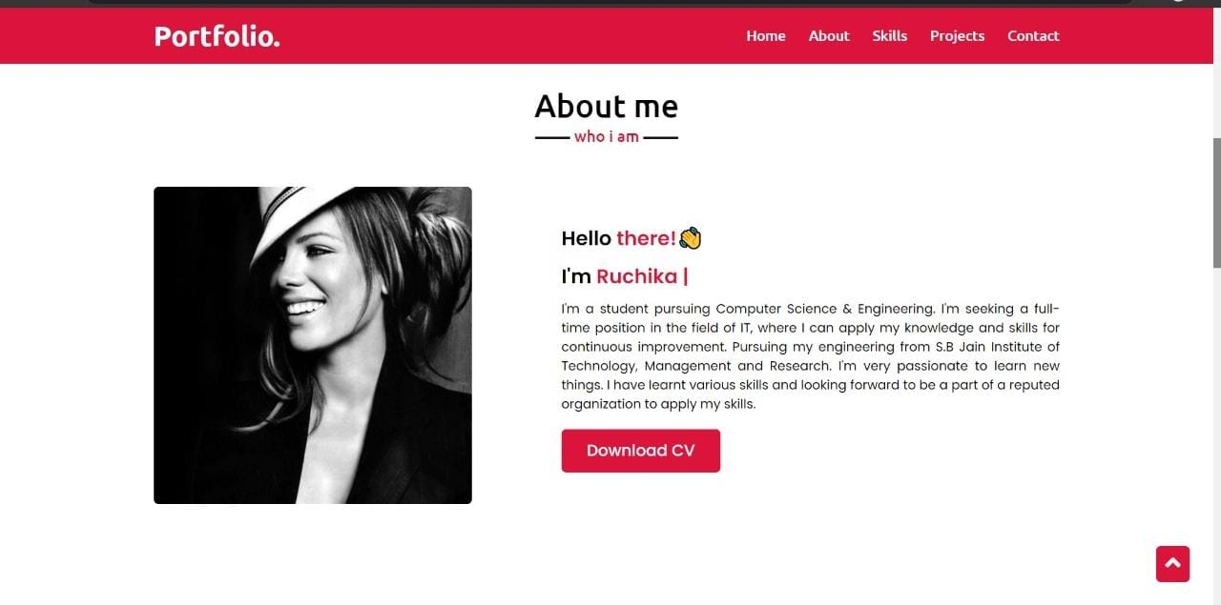
Screen Shots
S. B. Jain Institute of Technology Management and Research
8

Slide 9
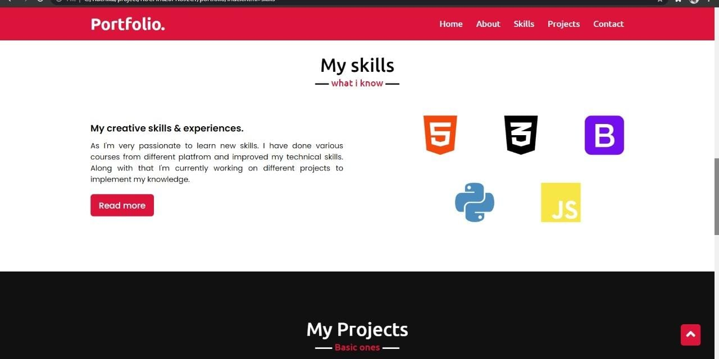
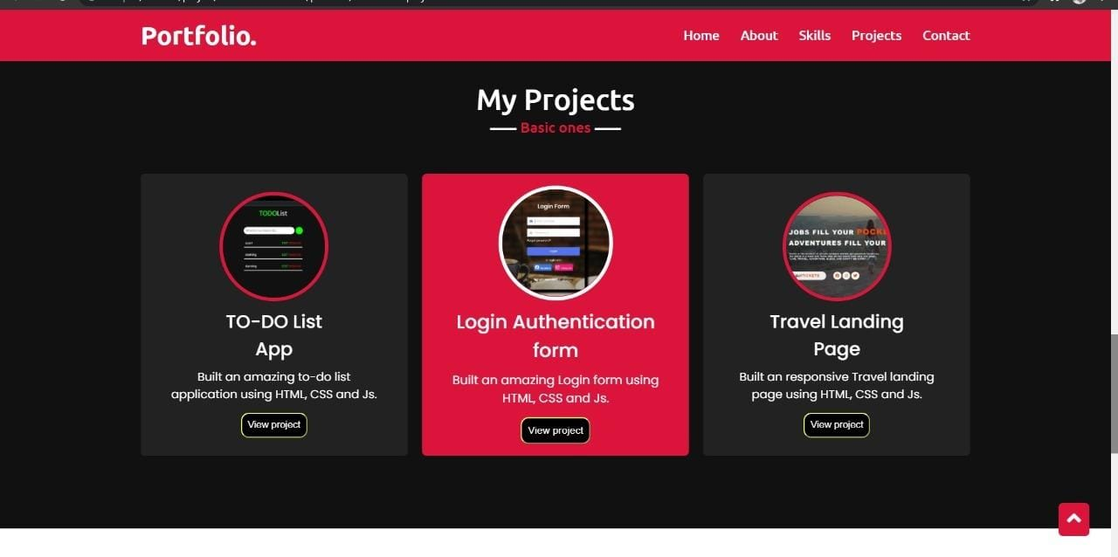

Slide 10
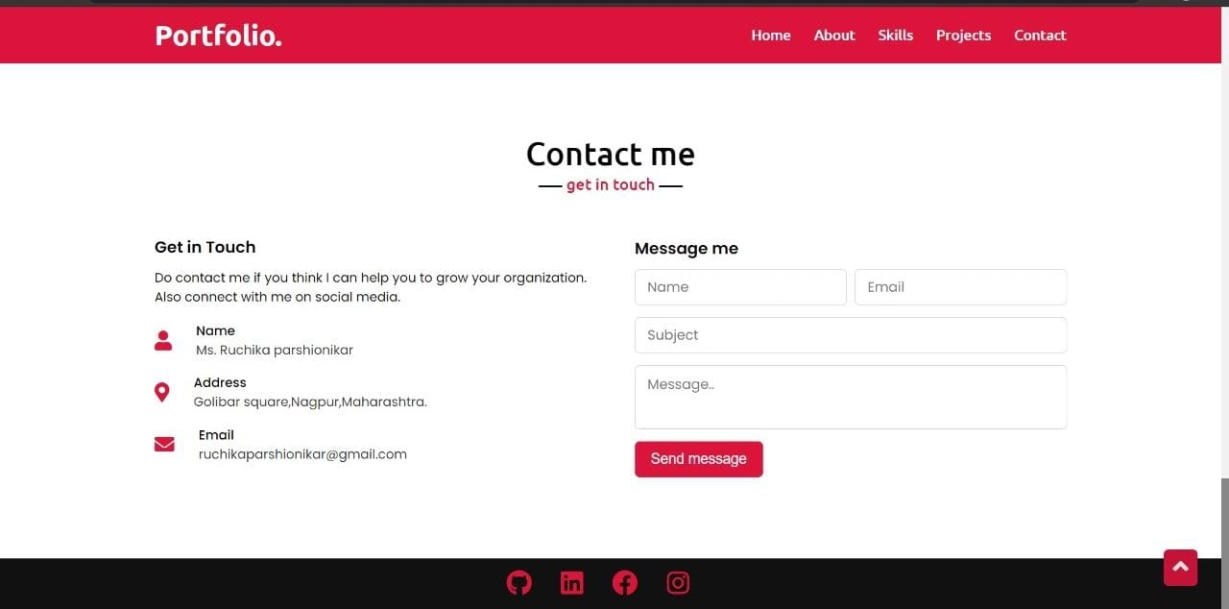

Slide 11
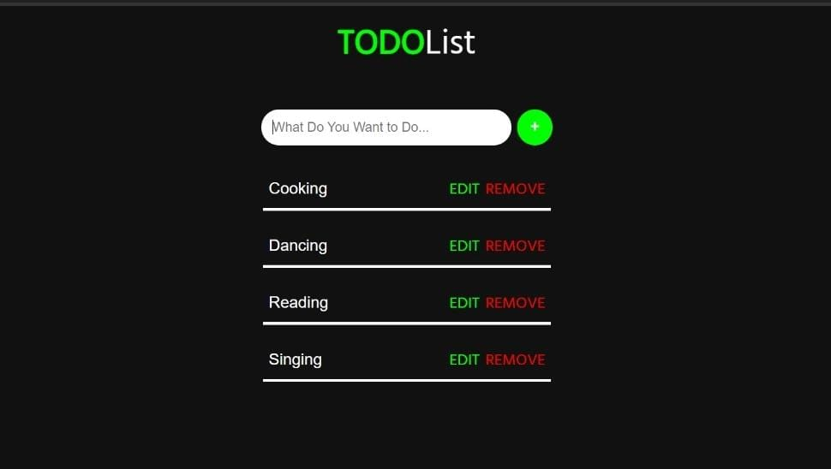
Works
To-do List App:
List of tasks you need to complete.
Organised in order of priority.
You can add, edit and remove.
S. B. Jain Institute of Technology Management and Research
11

Slide 12
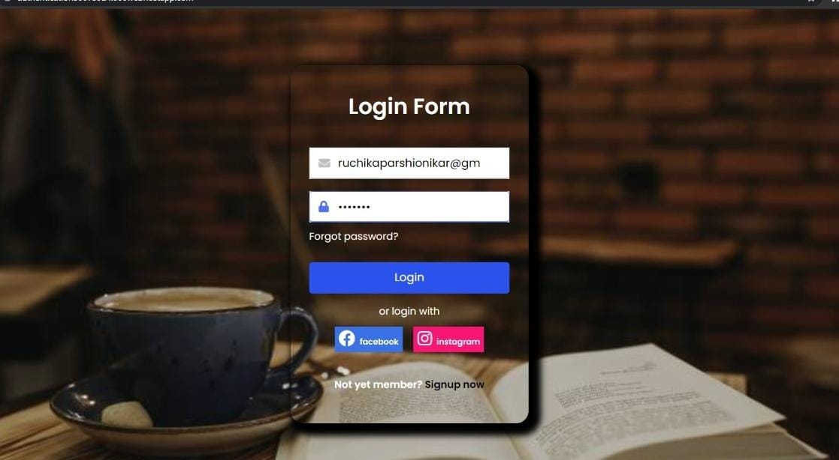
Login Form Authentication:
Form is used to enter authentication credentials to access a restricted page or form.
Contains a field for the username and another for the password.

Slide 13
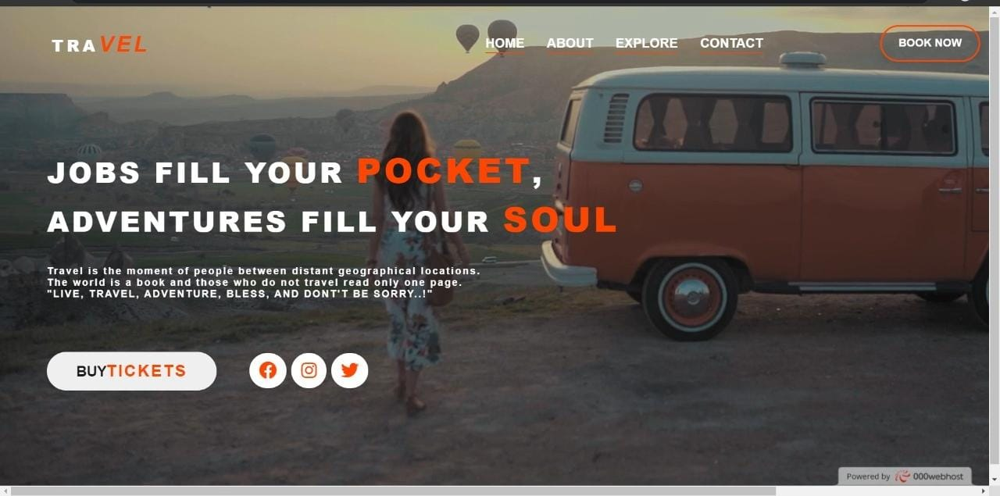
Landing page:
Landing page lets you make a trade, some sort of special offer, piece of information or a deal, in return for providing contact information.
The next step toward a visitor becoming a customer.

Slide 14
Advantages
Increased visibility and authority in your industry.
When someone searches your name in Google, your website appears at the top.
Hiring managers and clients can find you, instead of you trying to find them.
Gives you a chance to show off your creativity and personality.
Shows that you’re a professional, which means employers and clients are more likely to trust you and your work.
S. B. Jain Institute of Technology Management and Research
14

Slide 15
Conclusion
I have entirely completed my project, and designed my own portfolio. Throughout my portfolio you can see my work. Each project has a prompt and its own individual purpose. Every material I worked on had its own different skills. My portfolio is an example of how you can put everything together as one and let the audience see the beauty of your work.

Slide 16
References
Websites:
www.w3schools.com
https://kinsta.com/blog/portfolio-website/
https:// www.freshbooks.com/blog/how-to-create-online-portfolios-that-win-clients
S. B. Jain Institute of Technology Management and Research
16

Slide 17
Thank You

